Slide 1
Virtual Memory
Operating Systems (CS-2006) SPRING 2022, FAST NUCES
COURSE SUPERVISOR: ANAUM HAMID
anaum.hamid@nu.edu.pk

Slide 2
Virtual Memory
Virtual memory is a memory management capability of an OS, uses hardware and software to allow a computer to compensate for physical memory shortages by temporarily transferring data from random access memory (RAM) to disk storage.
Virtual memory is not RAM (Random access memory) on memory chips.
Virtual memory is an area of hard drive or other storage space, which OS uses as swap space (overflow) for the physical RAM.
When the demands of the software and data exceed the physical RAM size, the operating system copies to hard disk blocks of data from RAM that have been seldom used and releases that RAM for use by the current process.
When the block (or Page) is required again, the OS makes room in RAM by copying another block to hard drive and copying in the data from the first block.

Slide 3
Background
Virtual memory – separation of user logical memory from physical memory
Only part of the program needs to be in memory for execution
Logical address space can therefore be much larger than physical address space
Allows address spaces to be shared by several processes
Allows for more efficient process creation
More programs running concurrently
Less I/O needed to load or swap processes.
Virtual memory can be implemented via:
Demand paging
Demand segmentation

Slide 4
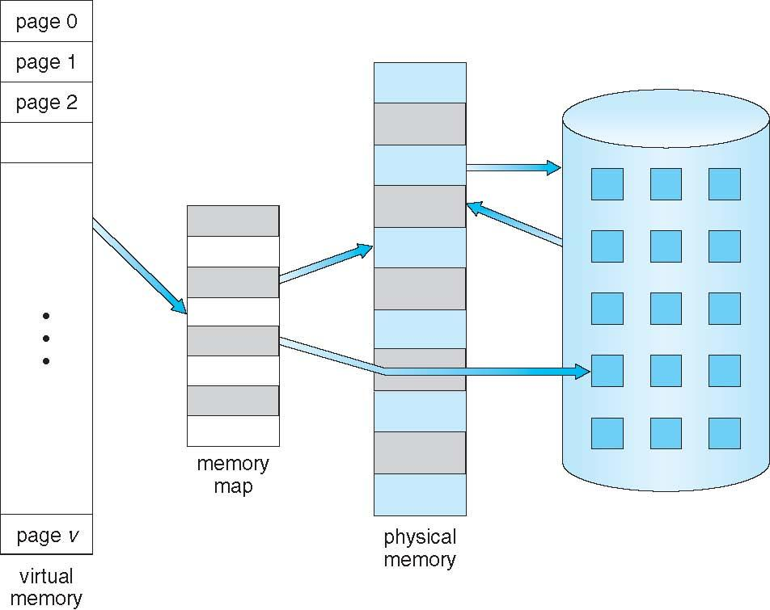
Virtual Memory That is Larger Than Physical Memory

Slide 5
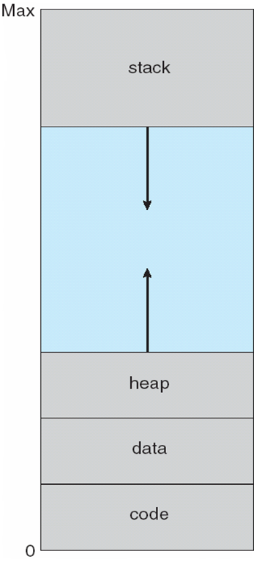
Virtual-address Space
Virtual address spaces that include holes are known as sparse address spaces.
System libraries shared via mapping into virtual address space
Shared memory by mapping pages read-write into virtual address space
Pages can be shared during fork(), speeding process creation

Slide 6
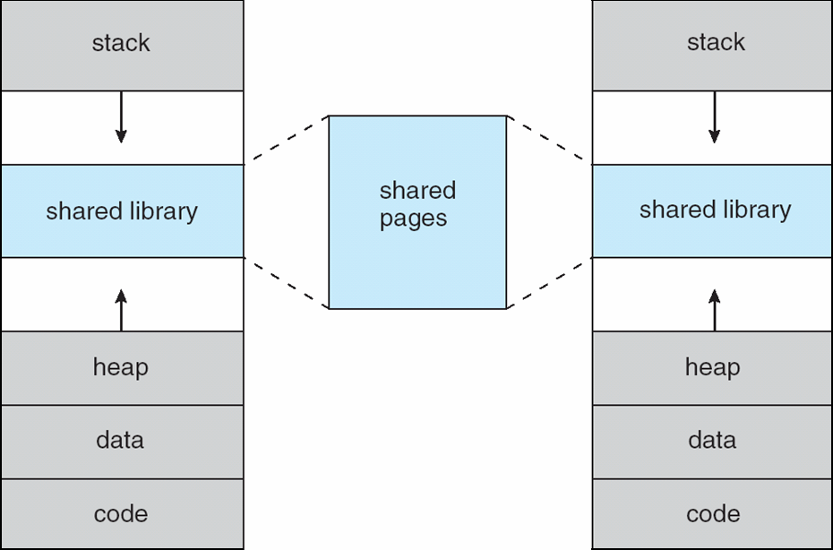
Shared Library Using Virtual Memory

Slide 7
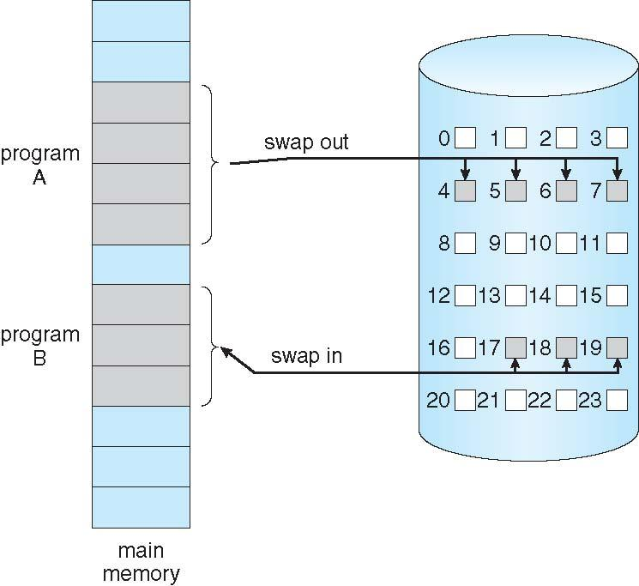
Demand Paging
Could bring entire process into memory at load time
Or bring a page into memory only when it is needed
Less I/O needed, no unnecessary I/O
Less memory needed
Faster response
More users
Page is needed ⇒ reference to it
invalid reference ⇒ abort
not-in-memory ⇒ bring to memory
Lazy swapper – never swaps a page into memory unless page will be needed
Swapper that deals with pages is a pager

Slide 8
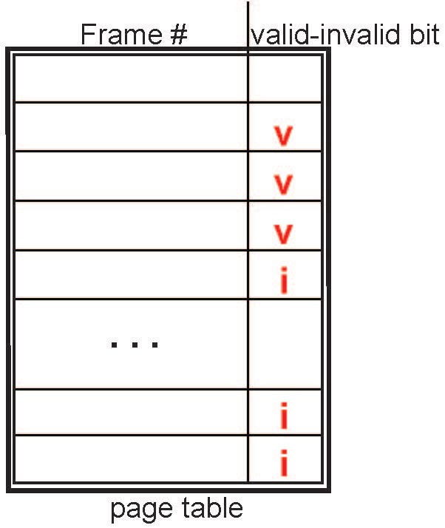
Valid-Invalid Bit
With each page table entry, a valid–invalid bit is associated (v ⇒ in-memory – memory resident, i ⇒ not-in-memory)
Initially valid–invalid bit is set to i on all entries
Example of a page table snapshot:
During MMU address translation, if valid–invalid bit in page table entry is i ⇒ page fault

Slide 9
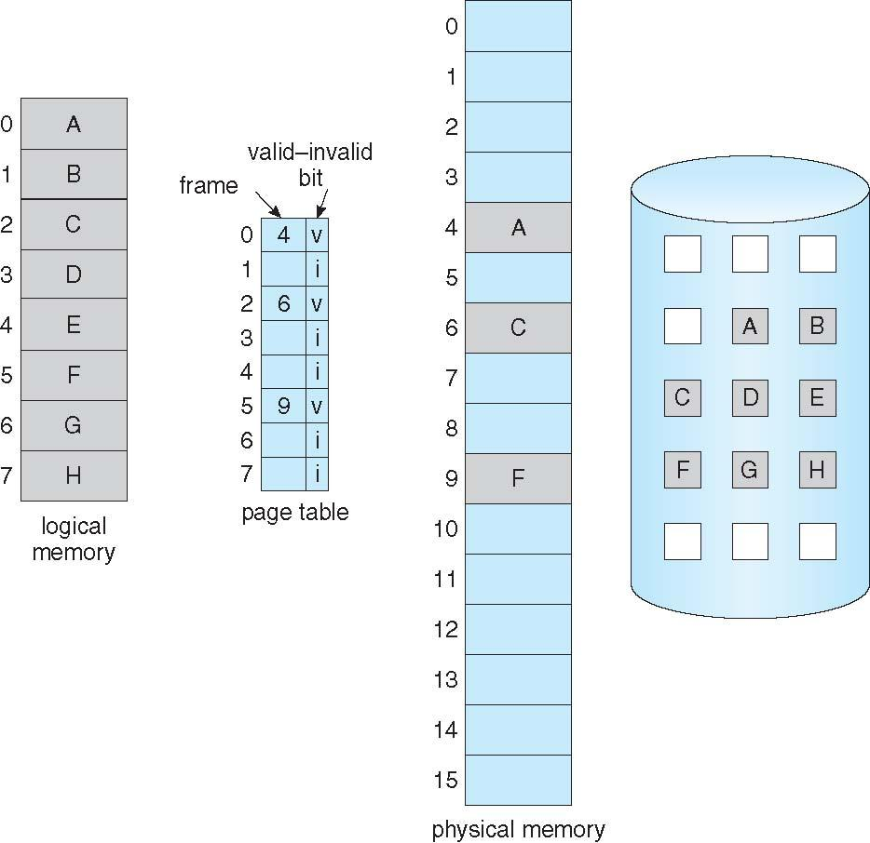
Page Table When Some Pages Are Not in Main Memory

Slide 10
Page Fault
If there is a reference to a page, first reference to that page will trap to operating system:
page fault
Operating system looks at another table to decide:
Invalid reference ⇒ abort
Just not in memory
Find free frame
Swap page into frame via scheduled disk operation
Reset tables to indicate page now in memory Set validation bit = v
Restart the instruction that caused the page fault

Slide 11
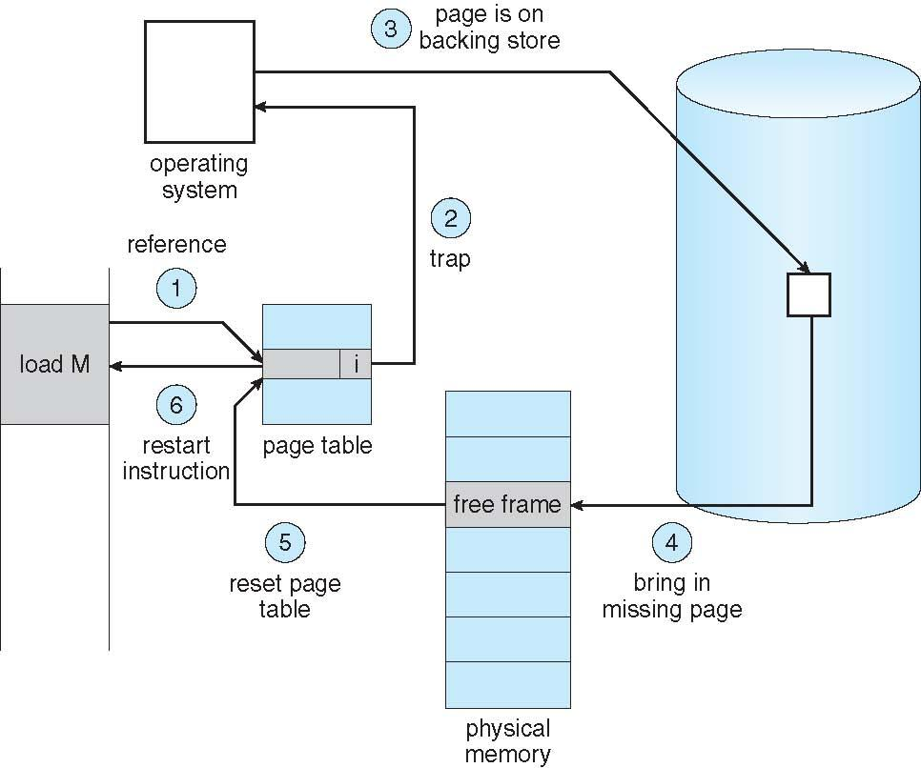
Steps in Handling a Page Fault

Slide 12
Aspects of Demand Paging
Extreme case – start process with no pages in memory
OS sets instruction pointer to first instruction of process, non-memory-resident -> page fault
And for every other process pages on first access
Pure demand paging
A given instruction could access multiple pages -> multiple page faults
Pain decreased because of locality of reference
Hardware support needed for demand paging
Page table with valid / invalid bit
Secondary memory (swap device with swap space)
Instruction restart

Slide 13
Performance of Demand Paging
Page Fault Rate 0 ≤ p ≤ 1
if p = 0 no page faults
if p = 1, every reference is a fault
Effective Access Time (EAT) =
EAT = (1 – p) x ma + p (page fault time)
page fault time = fault overhead+ swap page out+ swap page in

Slide 14
Page fault (EAT calculation)
Memory access time = ma = 200 nanoseconds
Average page-fault service time = page fault time = 8 milliseconds
If one access out of 1,000 causes a page fault, then
p = 1/1000 = 0.001
EAT = (1 – p) x ma + p (page fault time)
EAT = (1 – 0.001) x 200 + 0.001 x (8e -6)
EAT = 8199.8 nanoseconds
EAT = 8.199 microseconds
Millisecond = 10 e-3
Microsecond = 10e-6
Nanoseconds = 10e-9

Slide 15
Demand Paging Optimizations
Copy entire process image to swap space at process load time
Then page in and out of swap space
Used in older BSD Unix
Demand page in from program binary on disk, Demand pages for such files are brought directly from the file system.
Used in Solaris and current BSD

Slide 16
Copy-on-Write
Copy-on-Write (COW) technique allows both parent and child processes to initially share the same pages in memory
If either process modifies a shared page, only then is the page copied.
COW allows more efficient process creation as only modified pages are copied.
In general, free pages are allocated from a pool of zero-fill-on-demand pages
vfork() (for virtual memory fork) variation on fork() system call has parent suspend and child using copy-on-write address space of parent
Designed to have child call exec()
Very efficient

Slide 17
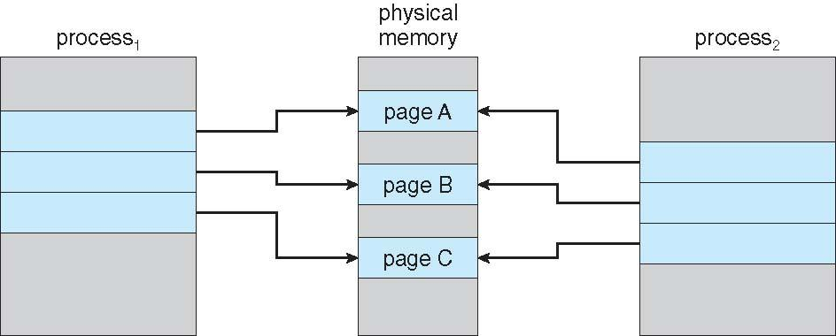
Before Process 1 Modifies Page C

Slide 18
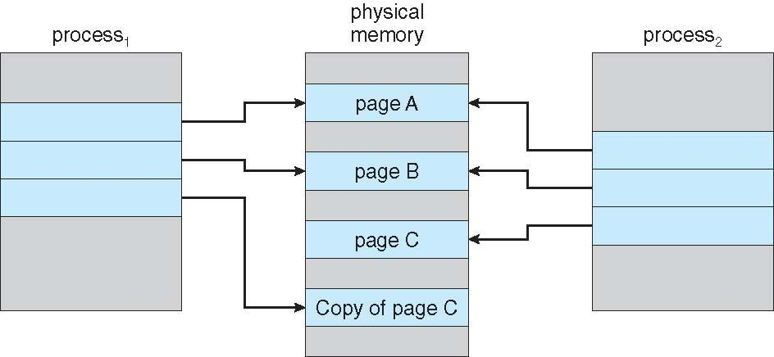
After Process 1 Modifies Page C

Slide 19
What Happens if There is no Free Frame?
Page replacement – find some page in memory, but not really in use, page it out
Algorithm – terminate? swap out? replace the page?
Performance – want an algorithm which will result in minimum number of page faults
Same page may be brought into memory several times.

Slide 20
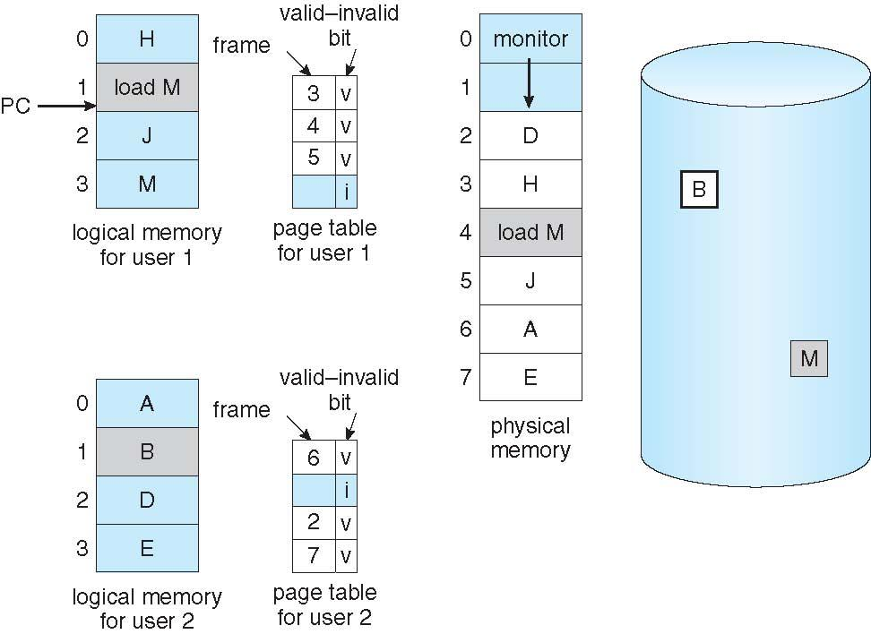
Need For Page Replacement

Slide 21
Basic Page Replacement Steps
Find the location of the desired page on disk
Find a free frame: - If there is a free frame, use it - If there is no free frame, use a page replacement algorithm to select a victim frame - Write victim frame to disk if dirty
Bring the desired page into the (newly) free frame; update the page and frame tables
Continue the process by restarting the instruction that caused the trap
Note now potentially 2-page transfers for page fault – increasing EAT

Slide 22
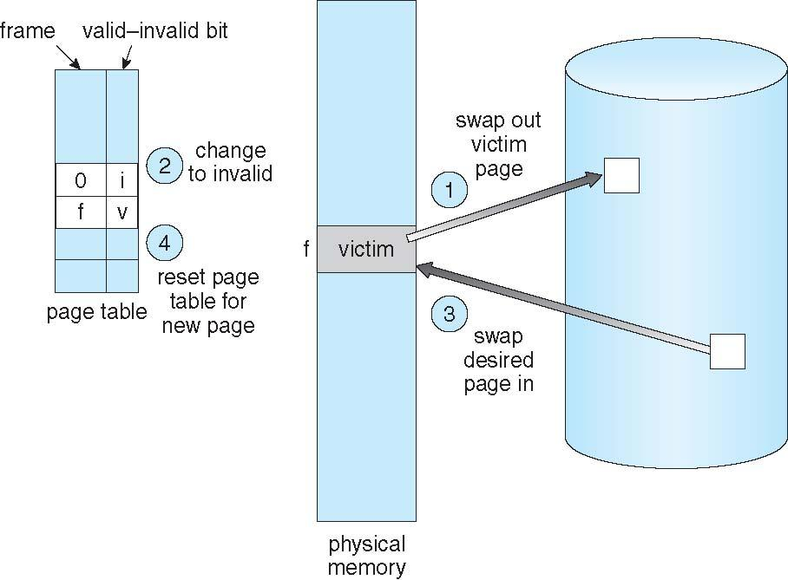
Page Replacement

Slide 23
Page Replacement
Page Replacement carried out by:
Page-replacement algorithm
Frame-allocation algorithm
Frame-allocation algorithm determines
How many frames to give each process
Which frames to replace
Page-replacement algorithm
Want lowest page-fault rate on both first access and re-access

Slide 24
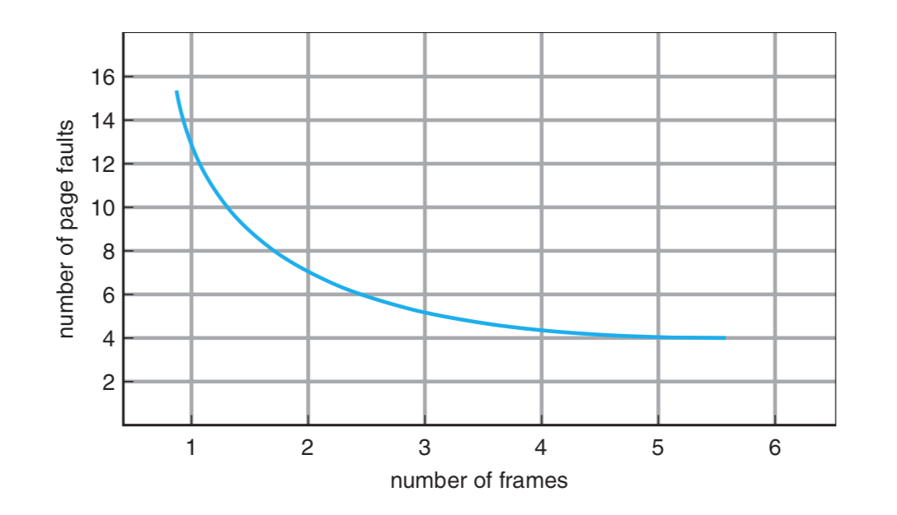
Graph of Page Faults Versus The Number of Frames

Slide 25
Page Replacement Algorithms
Basic page replacement algorithms are:
FIFO
Optimal Solution
LRU Algorithm
LRU –Approximation
Evaluate algorithm by running it on a particular string of memory references (reference string) and computing the number of page faults on that string
String is just page numbers, not full addresses
Repeated access to the same page does not cause a page fault
Results depend on number of frames available
In all our examples, the reference string of referenced page numbers is
6,0,1,2,0,3,0,5,2,3,0,3,0,3,2,1,2,0,1,6,0,1

Slide 26
First-In-First-Out (FIFO) Algorithm
The simplest page-replacement algorithm is a first-in, first-out (FIFO) algorithm. A FIFO replacement algorithm associates with each page the time when that page was brought into memory. When a page must be replaced, the oldest page is chosen.

Slide 27
6,0,1,2,0,3,0,5,2,3,0,3,0,3,2,1,2,0,1,6,0,1
Covered in Class
ratio | 6 | 0 | 1 | 2 | 0 | 3 | 0 | 5 | 2 | 3 | 0 | 3 | 0 | 3 | 2 | 1 | 2 | 0 | 1 | 6 | 0 | 1
f1
f2
f3

Slide 28
Optimal Page Replacement Algorithm
To Overcome Belady’s anomaly, optimal page-replacement algorithm introduced—the algorithm that has the lowest page-fault rate of all algorithms and will never suffer from Belady’s anomaly.
Such an algorithm does exist and has been called OPT or MIN. It is simply this:
Replace the page that will not be used for the longest period of time.
Use of this page-replacement algorithm guarantees the lowest possible page- fault rate for a fixed number of frames.

Slide 29
3,0,1,2,7,0,3,0,4,2,3,0,3,0,3,2,1,2,0,1,7,0,1
Optimal
ratio | 3 | 0 | 1 | 2 | 7 | 0 | 3 | 0 | 4 | 2 | 3 | 0 | 3 | 0 | 3 | 2 | 1 | 2 | 0 | 1 | 7 | 0 | 1
f1
f2
f3

Slide 30
Least Recently Used (LRU) Algorithm
LRU replacement associates with each page the time of that page’s last use.
When a page must be replaced, LRU chooses the page that has not been used for the longest period.
LRU strategy as the optimal page-replacement algorithm looking backward in time, rather than forward.

Slide 31
3,0,1,2,7,0,3,0,4,2,3,0,3,0,3,2,1,2,0,1,7,0,1
LRU–
ratio | 3 | 0 | 1 | 2 | 7 | 0 | 3 | 0 | 4 | 2 | 3 | 0 | 3 | 0 | 3 | 2 | 1 | 2 | 0 | 1 | 7 | 0 | 1
f1
f2
f3

Slide 32
LRU Algorithm (Cont.)
Counter implementation
Every page entry has a counter; every time page is referenced through this entry, copy the clock into the counter
When a page needs to be changed, look at the counters to find smallest value
Search through table needed
Stack implementation
Keep a stack of page numbers in a double link form:
Page referenced:
move it to the top
requires 6 pointers to be changed
But each update more expensive
No search for replacement

Slide 33
LRU Approximation Algorithms
LRU needs special hardware and still slow.
There are three LRU Approximation Algorithms:
Additional reference bit Algorithm
Second Chance Algorithm
Enhanced Second Chance Algorithm

Slide 34
LRU Approximation Algorithms
Reference bit Algorithm
With each page associate a bit, initially = 0
When page is referenced, bit set to 1
Replace any with reference bit = 0 (if one exists)
We do not know the order, however
Second-chance algorithm
Generally, FIFO, plus hardware-provided reference bit
Clock replacement
If page to be replaced has
Reference bit = 0 -> replace it
reference bit = 1 then:
set reference bit 0, leave page in memory
replace next page, subject to same rules

Slide 35
Second Chance Algorithm
Covered in Class
Rest of the material of 10.4 is reading summary assigned to students

Slide 36
10.5 Allocation of Frames
Each process needs minimum number of frames
Example: IBM 370 – 6 pages to handle SS MOVE instruction:
instruction is 6 bytes, might span 2 pages
2 pages to handle from
2 pages to handle to
Maximum of course is total frames in the system
Two major allocation schemes
fixed allocation
priority allocation
Many variations

Slide 37
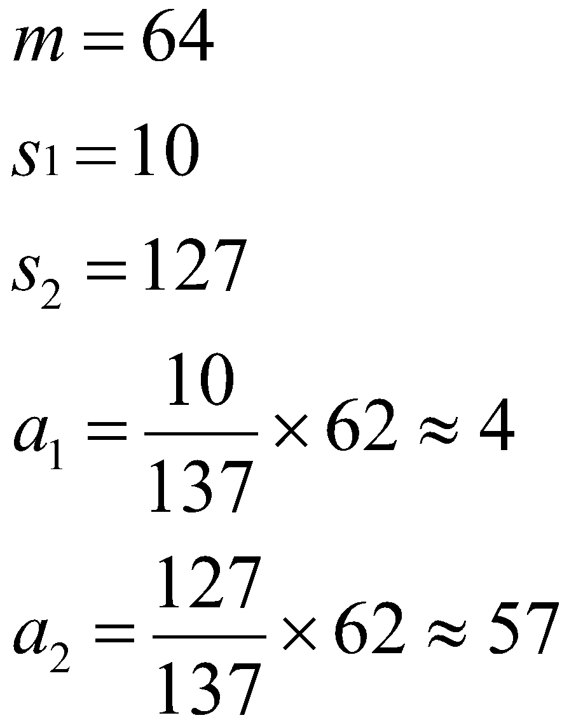
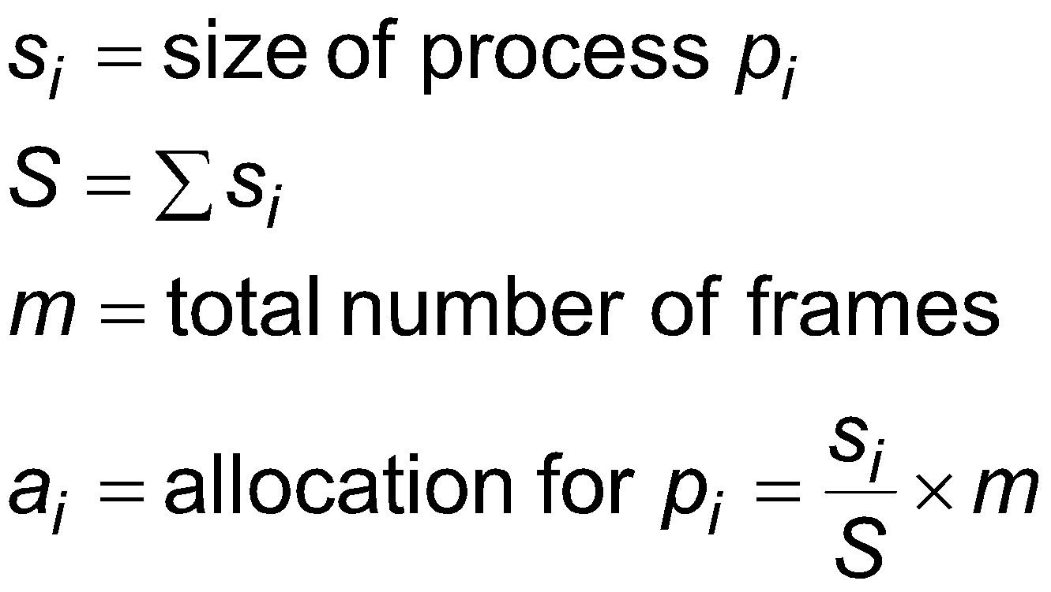
Fixed Allocation
Equal allocation – For example, if there are 100 frames (after allocating frames for the OS) and 5 processes, give each process 20 frames
Keep some as free frame buffer pool
Proportional allocation – Allocate according to the size of process
Dynamic as degree of multiprogramming, process sizes change

Slide 38
Priority Allocation
Use a proportional allocation scheme using priorities rather than size
If process P_{i} generates a page fault,
select for replacement one of its frames
select for replacement a frame from a process with lower priority number

Slide 39
Global vs. Local Allocation
Global replacement – process selects a replacement frame from the set of all frames; one process can take a frame from another
But then process execution time can vary greatly
But greater throughput so more common
Local replacement – each process selects from only its own set of allocated frames
More consistent per-process performance
But possibly underutilized memory

Slide 40
Thrashing
If a process does not have “enough” pages, the page-fault rate is very high
Page fault to get page
Replace existing frame
But quickly need replaced frame back
This leads to:
Low CPU utilization
Operating system thinking that it needs to increase the degree of multiprogramming
Another process added to the system
Thrashing ≡ a process is busy swapping pages in and out

Slide 41
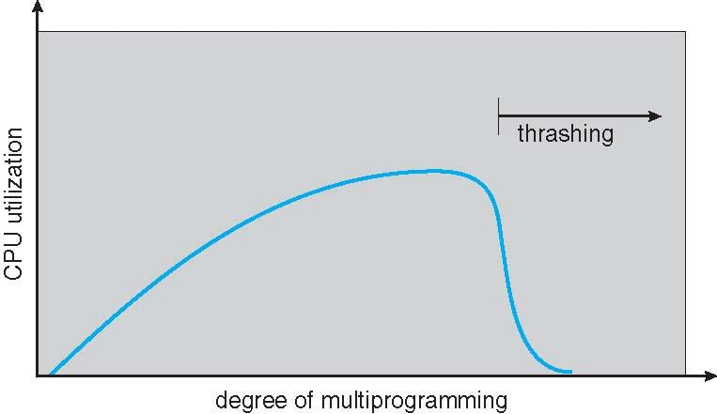
Thrashing (Cont.)

Slide 42
Allocating Kernel Memory
Treated differently from user memory
Often allocated from a free-memory pool
Kernel requests memory for structures of varying sizes
Some kernel memory needs to be contiguous
I.e. for device I/O

Slide 43
Buddy System
Allocates memory from fixed-size segment consisting of physically-contiguous pages
Memory allocated using power-of-2 allocator
Satisfies requests in units sized as power of 2
Request rounded up to next highest power of 2
When smaller allocation needed than is available, current chunk split into two buddies of next-lower power of 2
Continue until appropriate sized chunk available
For example, assume 256KB chunk available, kernel requests 21KB
Split into A_{L} _{and} A_{R} of 128KB each
One further divided into B_{L} and B_{R} of 64KB
One further into C_{L} and C_{R} of 32KB each – one used to satisfy request
Advantage – quickly coalesce unused chunks into larger chunk
Disadvantage - fragmentation

Slide 44
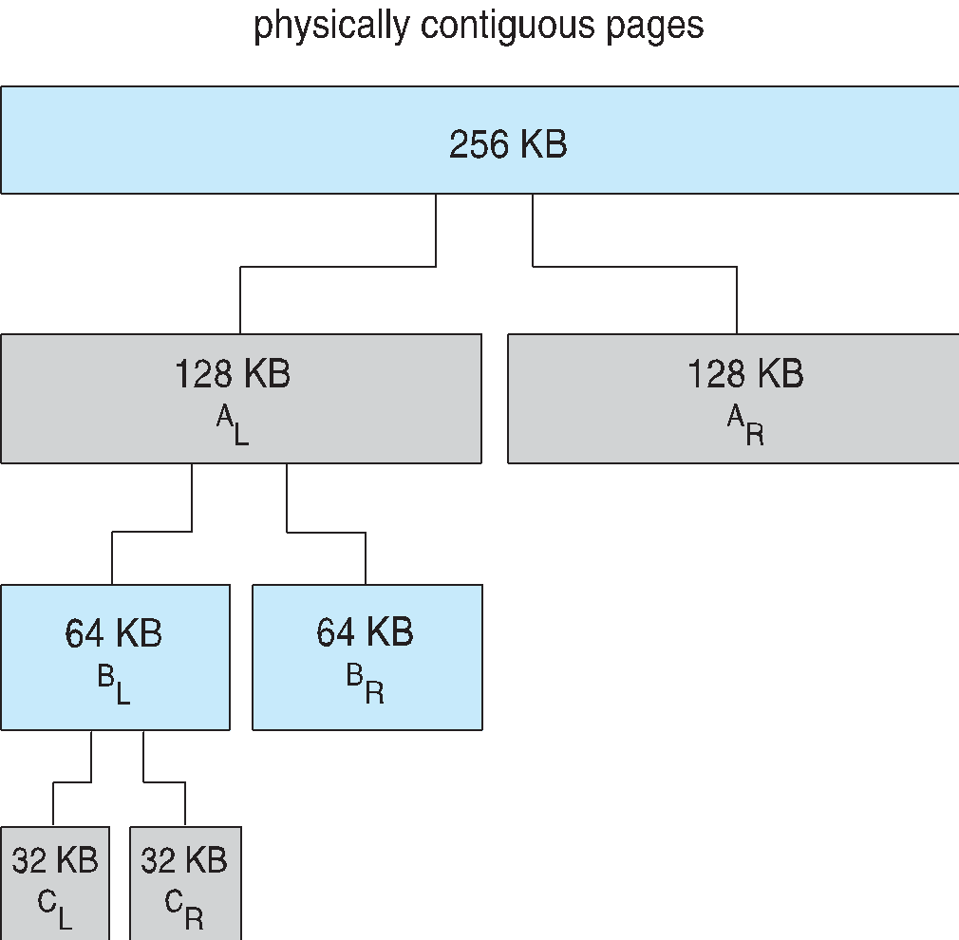
Buddy System Allocator

Slide 45
Slab Allocator
Alternate strategy
Slab is one or more physically contiguous pages
Cache consists of one or more slabs
Single cache for each unique kernel data structure
Each cache filled with objects – instantiations of the data structure
When cache created, filled with objects marked as free
When structures stored, objects marked as used
If slab is full of used objects, next object allocated from empty slab
If no empty slabs, new slab allocated
Benefits include no fragmentation, fast memory request satisfaction

Slide 46
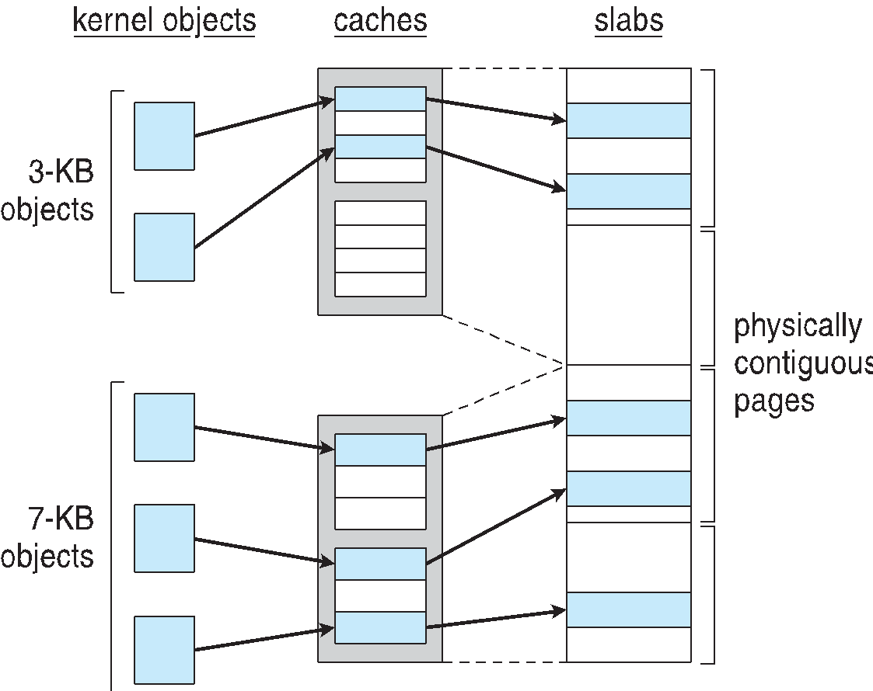
Slab Allocation

Slide 47
Other Considerations -- Prepaging
Prepaging
To reduce the large number of page faults that occurs at process startup
Prepage all or some of the pages a process will need, before they are referenced
But if prepaged pages are unused, I/O and memory was wasted
Assume s pages are prepaged and α of the pages is used
Is cost of s * α save pages faults > or < than the cost of prepaging s * (1- α) unnecessary pages?
α near zero ⇒ prepaging loses

Slide 48
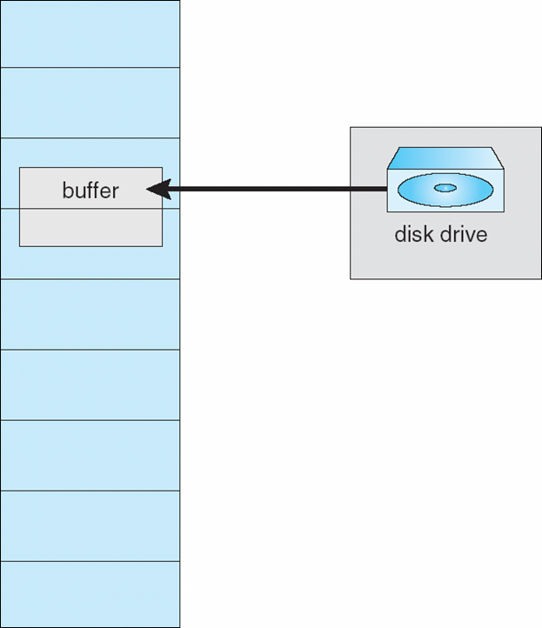
Other Issues – I/O interlock
I/O Interlock – Pages must sometimes be locked into memory
Consider I/O - Pages that are used for copying a file from a device must be locked from being selected for eviction by a page replacement algorithm
Pinning of pages to lock into memory

Slide 49
Thank You!

